Slide 1

Distributed and Mobile Systems
​​

Slide 2
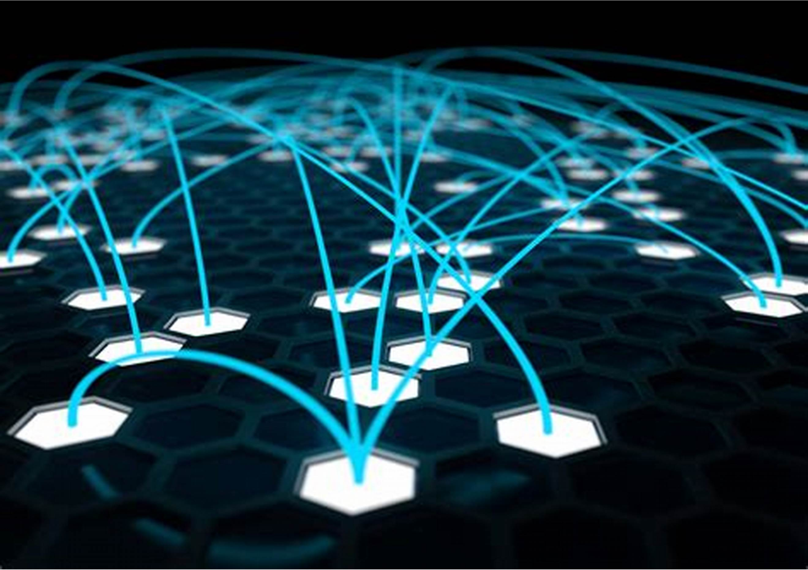
Outline:
1: Introduction
A brief definition & Importance of these systems In modern computing.
2: Security in Distributed and Mobile Systems
Security threats and challenges.
3: Role & types of Middleware in Distributed and Mobile Systems.
RPC, messaging, publish-subscribe.
Challenges in designing and implementing middleware
4: Characteristics
Key Challenges in Mobile Ad Hoc Computing
Assets for security in distributed real-time embedded systems

Slide 3
5: Case Studies
Real-world examples of distributed and mobile systems in use
Lessons learned from these examples
6: Future Trends
Emerging technologies and trends in distributed and mobile systems.
7: Conclusion
Recap of key points

Slide 4
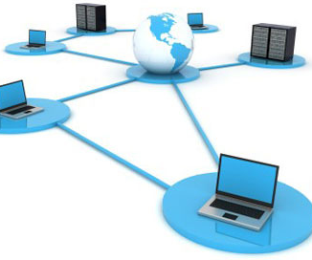
INTRODUCTION
Distributed and Mobile Systems are computing systems consisting of multiple nodes or devices connected through a network to perform a specific task. These systems can be deployed in a wide range of environments, such as enterprise networks, cloud computing, and mobile computing.

Slide 5
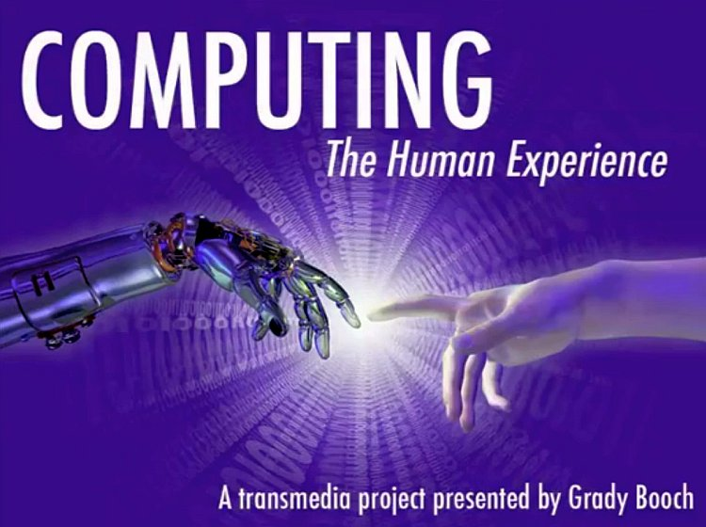
Importance in Modern Computing
Flexibility: Distributed systems can be easily customized and adapted to meet the specific needs of different users or applications. They can also be easily extended with new features or functionality as the needs of the business evolve.
2. Mobility: Mobile systems allow users to access services and data from anywhere and at any time, making them ideal for applications that require remote access or on-the-go usage.
3. Cost-effectiveness: Distributed and Mobile Systems can help reduce costs by consolidating hardware and software resources and reducing the need for physical infrastructure.
5

Slide 6

Security in Distributed and Mobile Systems
Security is a critical concern in Distributed and Mobile Systems, given the potential risks of data breaches, unauthorized access, and cyber-attacks.
Security in Distributed and Mobile Systems is critical to ensuring the confidentiality, integrity, and availability of data and resources. A combination of authentication and authorization, encryption, access control, secure communication, vulnerability management, and mobile device management can be used to secure these systems
6

Slide 7

Security threats and challenges
Malware and Viruses: Malware and viruses can infect mobile devices or servers in a distributed environment, causing data loss, system downtime, or unauthorized access. Malware can spread through emails, downloads, or social engineering attacks.
2:Unauthorized Access: Unauthorized access is a significant threat in a distributed environment, as it can result in data breaches, theft of sensitive information, or denial of service attacks. Hackers can exploit vulnerabilities in the system to gain access to critical data or resources.
3:Data Breaches: Data breaches occur when sensitive information is stolen or exposed to unauthorized parties. Data breaches can be caused by human error, such as weak passwords or poor security practices, or by malicious attacks such as hacking or phishing.
7

Slide 8
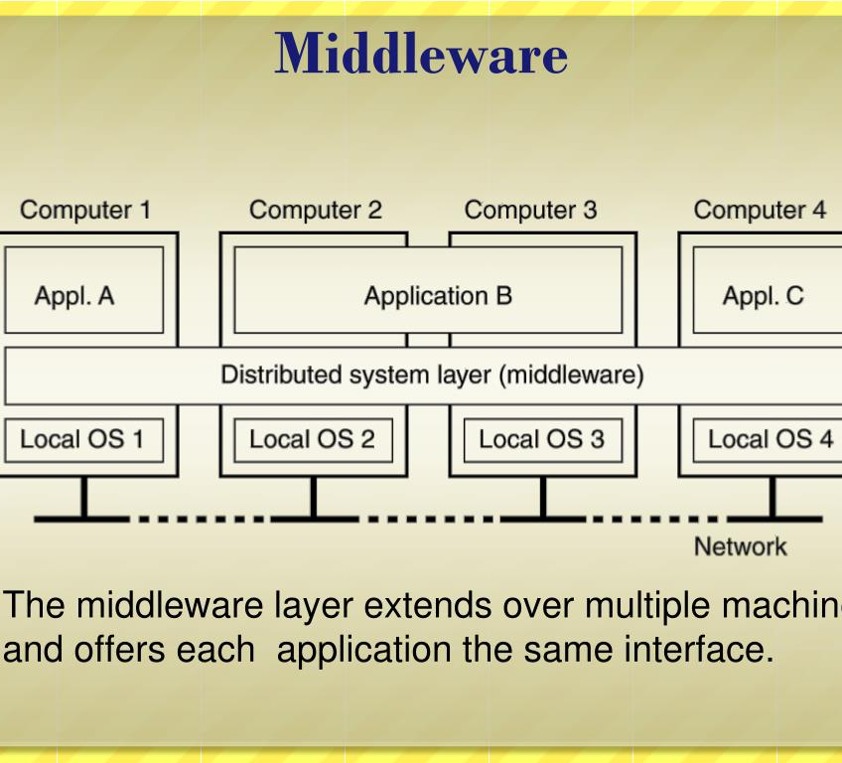

Role & Types of Middleware in Distributed and Mobile Systems.

Slide 9
RPC, messaging, publish-subscribe
1: RPC (Remote Procedure Call), messaging, and publish-subscribe are all communication patterns commonly used in distributed and mobile systems. Here's a brief explanation of each:
2: Remote Procedure Call (RPC): RPC is a communication pattern that enables one program to call a function or procedure in another program, typically on a remote server. The caller sends a message containing the function parameters to the server, which executes the function and returns the result..
3: Messaging: Messaging is a communication pattern that involves sending messages between different components or services in a distributed system. Messages can contain data, commands, or events, and are typically sent asynchronously, without the sender needing to wait for a response.
4: Publish-Subscribe: Publish-Subscribe is a communication pattern where publishers send messages to a message broker, which then distributes the messages to subscribers. Subscribers express interest in certain types of messages, and the broker sends them only the messages that match their interests.

Slide 10
Challenges in designing and implementing middleware
1: Heterogeneity: Middleware often needs to support multiple programming languages, operating systems, and hardware platforms, which can create challenges in developing a consistent interface and ensuring interoperability between different systems
2: Scalability: Middleware must be designed to handle a large volume of requests and data transfers, which can be a complex problem in highly distributed systems where resources are spread across multiple nodes.
3:Performance: Middleware must be designed to handle communication between different components efficiently, without introducing significant delays or bottlenecks.
4:Security: Middleware must be designed to protect against unauthorized access, data breaches, and other security threats. This can be challenging, as middleware often sits between different systems and must balance the need for security with the need for efficient communication

Slide 11
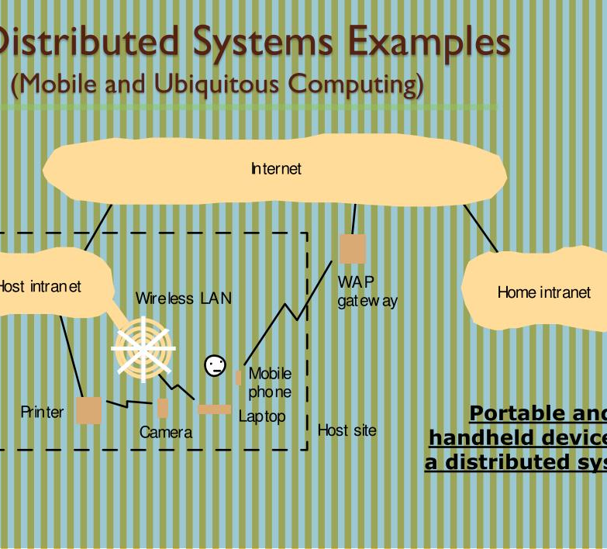
Characteristics.
Characteristics of Key Challenges in Mobile Ad Hoc Computing & Assets for Security in Distributed Real-Time Embedded Systems

Slide 12
Key Challenges in Mobile Ad Hoc Computing
Dynamic network topology: Mobile devices in a MANET can move around and join or leave the network at any time, causing the network topology to change dynamically. This makes it challenging to maintain consistent communication and routing in the network.
Limited resources: Mobile devices typically have limited battery life, processing power, and storage capacity, which can make it difficult to perform complex computations or store large amounts of data.
Security: MANETs are vulnerable to security threats such as eavesdropping, tampering, and denial of service attacks. The lack of a centralized authority or fixed infrastructure makes it challenging to implement security mechanisms to protect the network.
4: Quality of Service (QoS): Mobile devices may have varying network connectivity and bandwidth, which can affect the quality of service (QoS) for different applications. Ensuring a consistent level of QoS for all applications in a MANET can be a challenge.
5: Mobility management: Managing the mobility of devices in a MANET can be a challenge, as it requires tracking device movement and updating routing tables to reflect changes in the network topology.
6: Scalability: As the number of devices in a MANET increases, it can become more challenging to maintain efficient communication and routing in the network.

Slide 13
Assets for security in distributed real-time embedded systems
Real-time constraints: DRTES typically have strict timing constraints, which can be used as an asset for security. By analyzing the timing of system events, it is possible to detect and prevent attacks that might compromise system security.
Resource constraints: DRTES typically have limited resources, including processing power, memory, and bandwidth. These resource constraints can be used as an asset for security by limiting the attack surface and making it more difficult for attackers to exploit vulnerabilities.
Custom hardware and software: DRTES are often built using custom hardware and software, which can make it more difficult for attackers to understand and exploit system vulnerabilities. Custom hardware and software can also be designed with security in mind, incorporating features such as encryption and secure boot processes.
3: Separation of concerns: DRTES often have a modular architecture that separates different components and services. This separation can be used as an asset for security by limiting the impact of attacks and making it easier to detect and isolate compromised components.
4: Redundancy and fault tolerance: DRTES often include redundancy and fault tolerance mechanisms to ensure system reliability. These mechanisms can also be used as an asset for security by providing backup systems and fail-safe modes that can prevent attacks or mitigate their impact.
5: Formal verification: DRTES are often designed using formal methods and techniques, which can be used as an asset for security. Formal verification can help identify and prevent security vulnerabilities by providing a rigorous analysis of system behavior and ensuring that the system meets its design specifications.

Slide 14
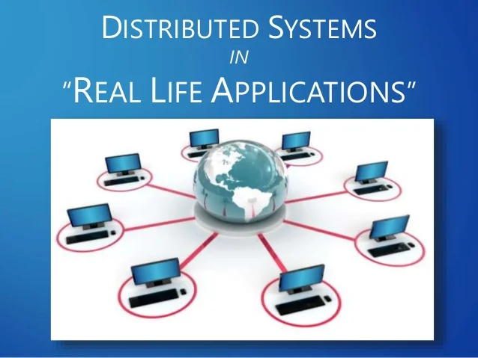
Case Studies
Google File System (GFS) is a distributed file system that was developed by Google to store and manage large datasets across a cluster of commodity servers. GFS was designed to provide high availability, fault tolerance, and scalability, making it an ideal choice for large-scale data processing applications.

Slide 15
Real-world examples of distributed and mobile systems in use
Uber: Uber is a mobile-based transportation system that relies on distributed systems for its operation. The Uber app allows riders to connect with nearby drivers, and the app's backend uses distributed systems to match riders with drivers, calculate fares, and handle payments.
Amazon Web Services (AWS): AWS is a cloud computing platform that provides a wide range of services to businesses and organizations. AWS relies on distributed systems to provide high availability and scalability for its customers, and it uses distributed systems to manage the resources needed to run its services.
NASA's Deep Space Network (DSN): DSN is a distributed system that is used to communicate with deep space missions, such as the Voyager and Mars rovers. DSN relies on a network of antennas and other communication equipment to send and receive data from these missions, and it uses distributed computing to manage the resources needed to communicate with multiple missions simultaneously.

Slide 16
Lessons learned from these examples
1: Scalability and fault tolerance are critical: Systems that rely on distributed and mobile technologies must be designed with scalability and fault tolerance in mind. Uber and AWS are good examples of systems that have been designed to handle large amounts of traffic and provide high availability.
2: Security is a major concern: Systems that rely on distributed and mobile technologies must be designed with security in mind. The Bitcoin network, for example, uses advanced cryptography to secure its transactions and prevent fraud.
3: Real-time communication is important: Systems that rely on distributed and mobile technologies often require real-time communication to function properly. NASA's DSN is a good example of a system that requires real-time communication to send and receive data from deep space missions.

Slide 17
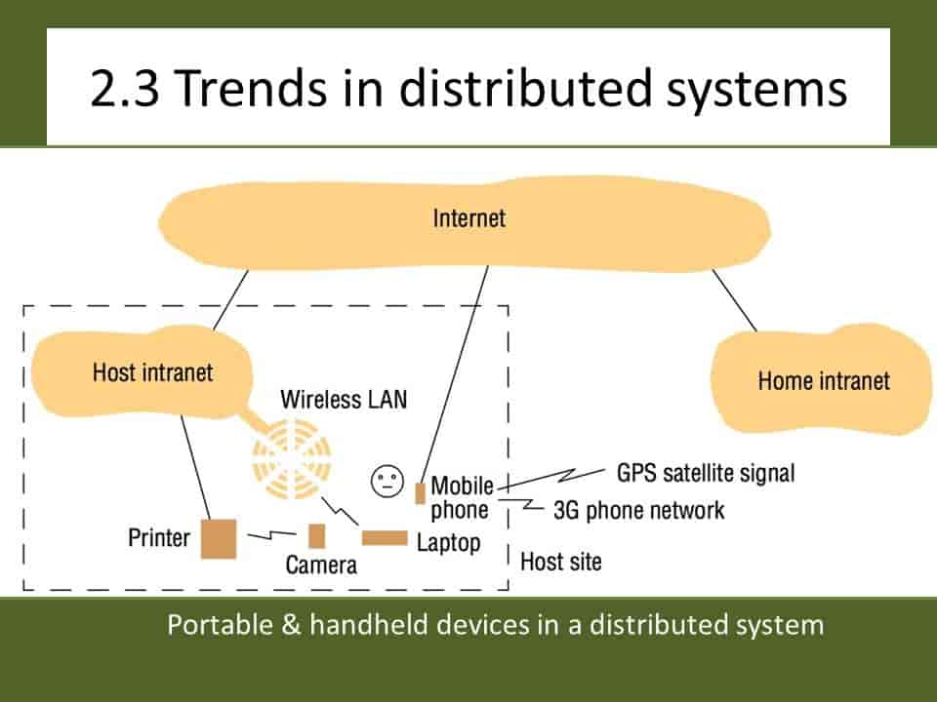

Future Trends
here are some future trends in distributed and mobile systems

Slide 18
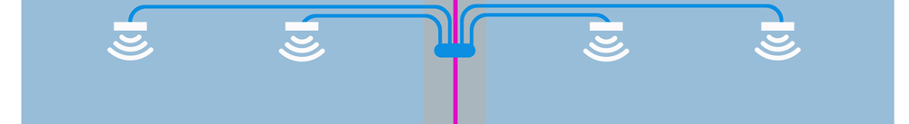
Emerging technologies and trends in distributed and mobile systems
1: Internet of Things (IoT): The IoT is a network of interconnected devices that can communicate with each other and exchange data. As more devices become connected to the internet, there will be an increasing need for distributed systems that can manage and process the data generated by these devices.
2: Edge Computing: Edge computing is a distributed computing model that allows data to be processed closer to the source of the data, rather than in a centralized data center. This approach can reduce latency and improve performance, making it well-suited for applications that require real-time processing.
3: Blockchain: Blockchain is a distributed ledger technology that allows transactions to be securely recorded and verified without the need for a central authority. Blockchain technology has the potential to disrupt industries such as finance and supply chain management, and it may become a key technology for distributed systems in the future.
18

Slide 19
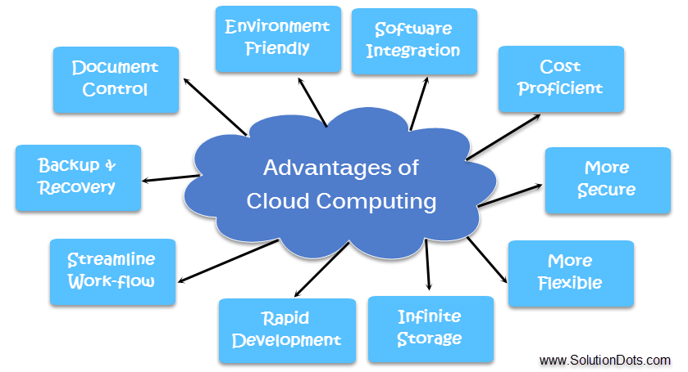
Conclusion
In conclusion, distributed and mobile systems are essential components of modern computing. These systems enable us to connect devices and users across the globe and to process and analyze vast amounts of data. However, the design and implementation of these systems present a number of challenges, particularly with regard to security, middleware, and real-time embedded systems. Nevertheless, with ongoing research and development in areas such as IoT, edge computing, blockchain, serverless computing, and distributed machine learning, we can expect to see continued growth and innovation in the field of distributed and mobile systems in the future.

Slide 20
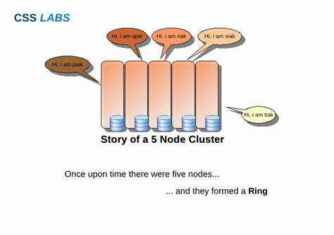
Recap of key points
1: Distributed and mobile systems are critical for modern computing, enabling devices and users to connect and process large amounts of data.
2: Security is a key challenge in distributed and mobile systems, with threats such as data breaches and cyber-attacks posing significant risks.
3: Middleware is another challenge, as designing and implementing middleware requires addressing issues such as scalability, interoperability, and fault tolerance.
4: Mobile ad hoc computing and distributed real-time embedded systems are two key applications of distributed and mobile systems, each presenting unique challenges and opportunities.
5: Future trends in distributed and mobile systems include IoT, edge computing, blockchain, serverless computing, and distributed machine learning.
20

Slide 21
THANK YOU

